Slide 1
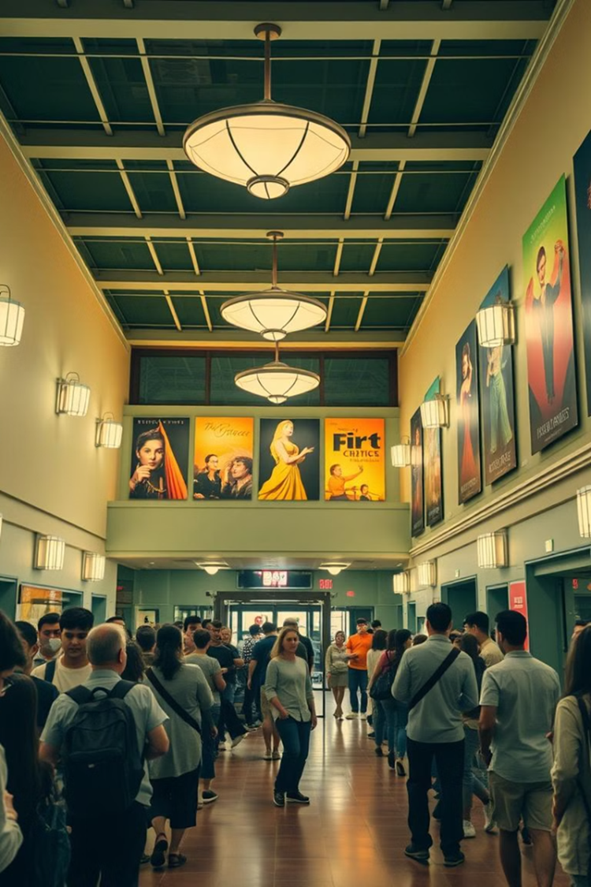
INTRODUCTION
The Theater Renovation Planner is a software solution designed to assist in planning, scheduling, and monitoring renovations for aging theaters.
It allows users to create, read, update, and delete renovation plans while tracking the impact on theater attendance and customer satisfaction.
The project leverages Python and Object-Oriented Programming principles for a streamlined and efficient approach to theater renovation management.

Slide 2
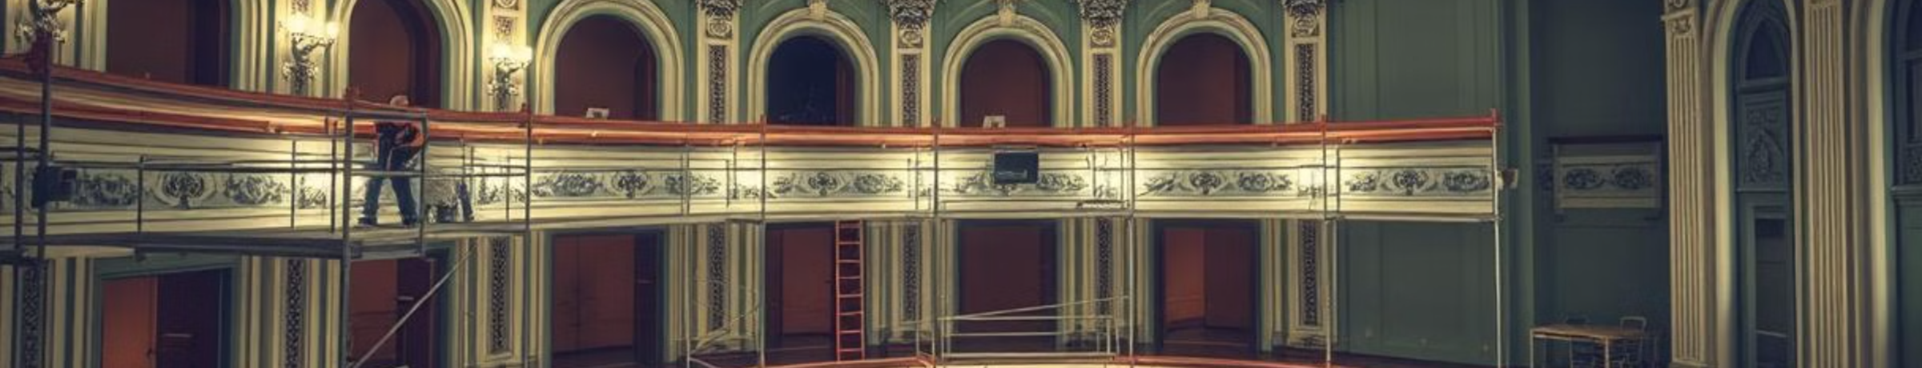
OBJECTIVE
The primary objective is to provide a user-friendly system for managing theater renovations.
To enhance the decision-making process by planning, scheduling, and assessing the effects of renovations on theater operations and attendance.
To simplify renovation management by automating the tracking and monitoring process.

Slide 3

Existing System / Proposed System:
Existing System:
Renovation planning often relies on manual methods such as spreadsheets, which are prone to human errors and inefficiency.
Tracking renovation impacts on audience satisfaction is often neglected.
Proposed System:
Automated software for planning, scheduling, and monitoring renovations.
Real-time tracking of renovation impacts on key performance indicators.
Centralized data management through an easy-to-use interface.

Slide 4
VISION:
Our vision is to make theater renovations easier and more efficient by providing a tool that helps plan and manage projects without hassle.
We aim to help theaters stay modern and well-maintained, improving audience satisfaction and theater operations.
MISSION:
Our mission is to create a simple and reliable system that automates and simplifies the renovation process for theaters.
We aim to provide a system that is easy to use, helping theater owners save time and money, and ensuring renovations are done smoothly and effectively.

Slide 5


Requirements Specification:
Non-Functional Requirements:
User-friendly interface.
Scalability to handle multiple renovation projects.
Secure data storage and processing.
Functional Requirements:
CRUD operations for renovation plans.
Scheduling functionality for renovation projects.
Monitoring renovation impacts (attendance, satisfaction).

Slide 6
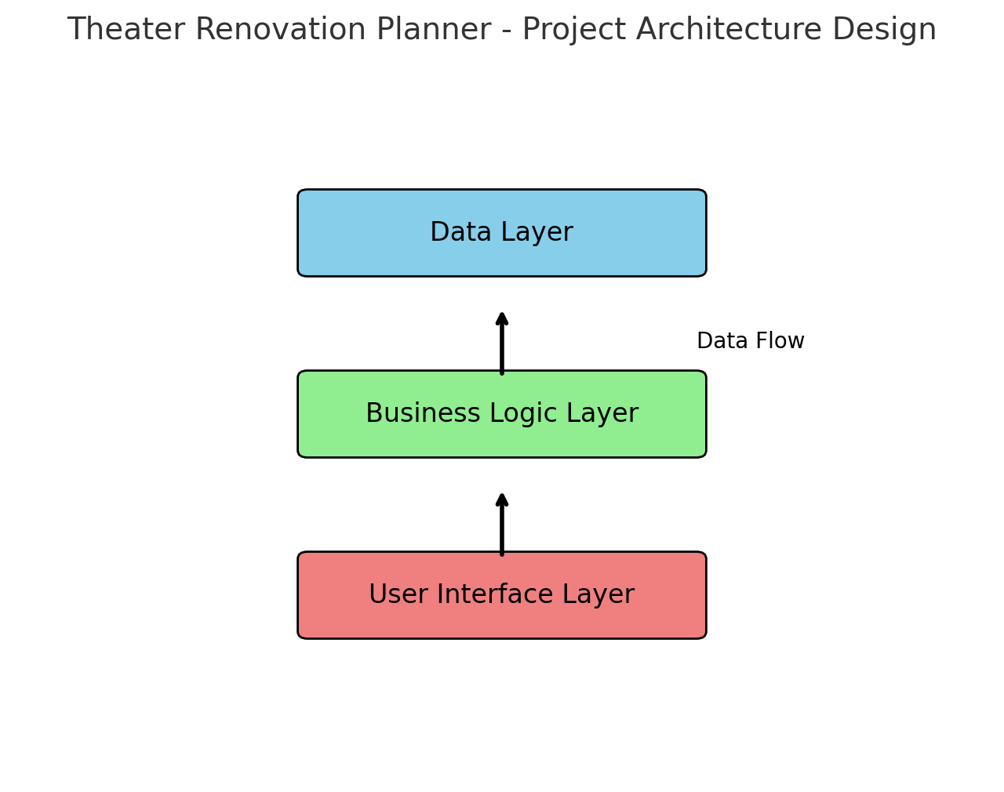
Project Architecture Design:

Slide 7
Modules:
Renovation Plan Management: Adding, updating, and removing renovation plans.
Scheduling Module: Plans and schedules renovations.
Monitoring Module: Tracks the effects of renovations on theater performance.
User Interface: Simple and interactive system to navigate through functionalities.
Benefits:
Reduces the complexity of managing multiple renovation projects.
Provides real-time insights into the success of renovations.
Improves planning and resource allocation for theater owners.
Enhances customer satisfaction through better facility management.

Slide 8
Conclusion:
The Theater Renovation Planner POC aims to simplify theater renovations through automation and real-time impact tracking.
It improves operational efficiency, audience experience, and resource management for theaters.
References:
Python documentation for OOP principles.
Case studies on renovation project management.
Research articles on theater renovations and customer satisfaction.

Slide 9


